Slide 1
CUSTOMER FEEDBACK ANALYSIS
SABARINATH MURALIDHARAN SUJATHA
19 November 2022

Slide 2
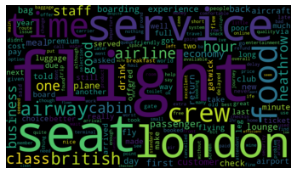
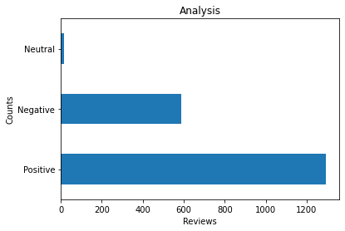
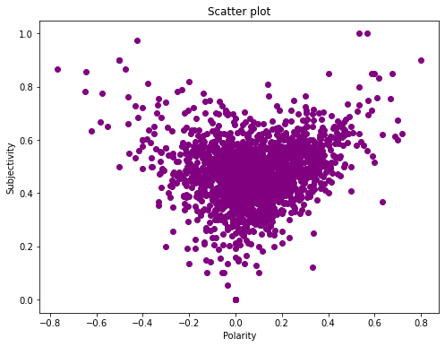
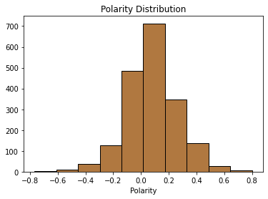
Insights Summary
Number of positive reviews are more than double the number of negative reviews
Majority of the feedback is centred around 0.5 subjectivity which implies that
the customer feedbacks are neither much opinionated nor much factual
Strongly positive or strongly negative reviews are very less and most of the
feedbacks are close to neutral reviews
Commonly used words are Flight, Seat, London, Crew, Service and Food

